Slide 1
SQL in 1 Hour
Everything You Wanted to Know About SQL, but Were Afraid to Ask…

Slide 2
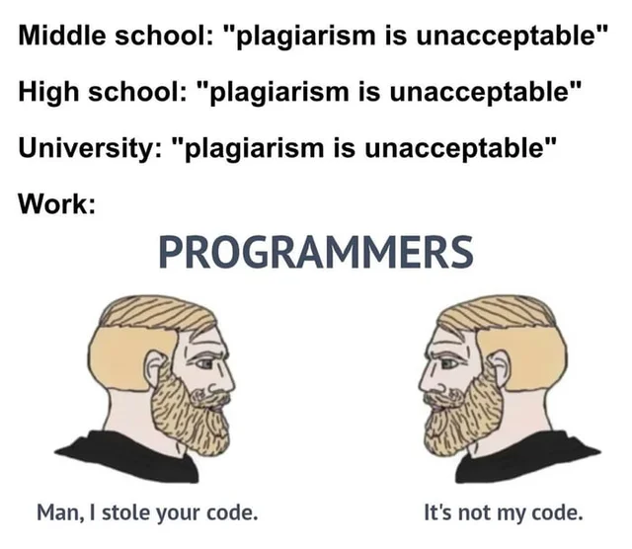

Slide 3
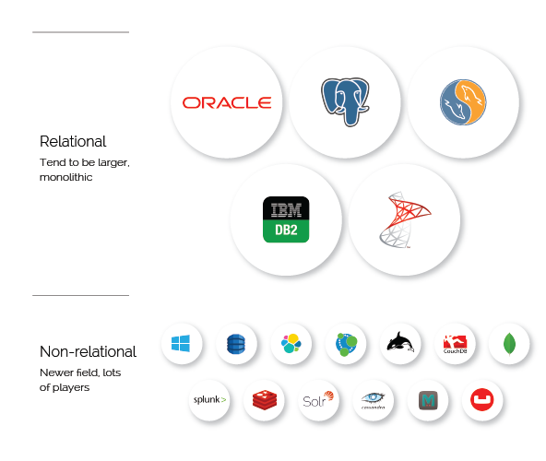
What is SQL?
Like any computer language, SQL is a protocol for talking to a machine.
SQL, specifically, is interested in talking to a specific machine: a database.
Most people are familiar with databases as a concept.
SQL is mostly specific to a certain type of database: relational databases.

Slide 4
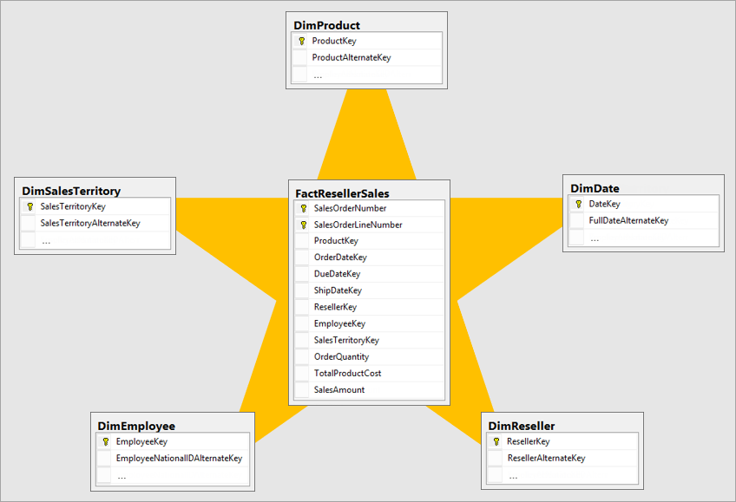
Features of a Relational Database
For our purposes, relational databases have these salient features:
Relational databases have tables, are tabular
They have (hopefully) primary keys
They’re accessed through RDBMS
They have schema

Slide 5


What’s the difference between SQL and No-SQL?
SQL
No-SQL

Slide 6

What do I need to know?
The big five and the dark art of relational joins…
SELECT
FROM
WHERE
GROUP BY
ORDER BY
…JOIN
Watch out! We’re going out of order!

Slide 7
FROM
/* This is a comment */
/* “SELECT *” means show everything */
SELECT *
FROM db.schema.customers c
LIMIT 100;
/* Best practice:
Always end your queries with a LIMIT clause so your query doesn’t go wild. */
The FROM clause identifies the database table that you want to get stuff from.
It is the second required clause after SELECT.
Basic syntax looks like this:
FROM db.public.customers c
“db” is the name of the database
“public” is the name of the schema
“customers” is the name of the table
“c” is the alias of the FROM reference
The path from database to table is concatenated using the “.” in what is called “Dot Notation”

Slide 8
SELECT
/* Hot tip: if you put the comma at the beginning of the line, you can quickly comment and uncomment. */
—- double hyphens are single line comments
SELECT c.firstname AS firstname
—-, c.address + “ “ + c.city + “ “ + c.state + “ “ + c.country AS fulladdress
FROM db.schema.customers c
LIMIT 100;
You SELECT the columns that you want to display.
You can also do operations on these items, e.g.:
Aggregations, like SUM or COUNT
CONCATENATE, like if you wanted to put two columns into one
You can also create entirely new columns
Remember to ALIAS your columns!

Slide 9
WHERE
SELECT c.firstname + “ “ + c.lastname AS fullname
—-, c.address + “ “ + c.city + “ “ + c.state + “ “ + c.country AS fulladdress
FROM db.schema.customers c
WHERE c.country IN (“USA”,”Canada”)
, c.joinDate BETWEEN “2022-01-01” AND “2022-02-01”
, c.joinMachine = “181415”
LIMIT 100;
The WHERE clause is a filter, e.g.:
Use comparators to filter
=, or equals
!=, or not-equals
<, >, or greater than and less than
<=, >= greater than or equal to and less than or equal to
BETWEEN, used for dates
IN, equals to multiple items
LIKE, where you can use wildcards like “%”

Slide 10
ORDER BY
SELECT c.firstname + “ “ + c.lastname AS fullname
FROM db.schema.customers c
WHERE c.country IN (“USA”,”Canada”)
, c.joinDate BETWEEN “2022-01-01” AND “2022-02-01”
, c.joinMachine = “181415”
ORDER BY c.state ASC,
C.lastname DESC
LIMIT 100;
/* Notice that you don’t need to have a column in SELECT to sort by it */
This is the sorting feature.
You can sort multiple columns in order.
ASC = ascending
DESC = descending
This query will sort by state in alphabetical order and then last name in reverse alphabetical order.

Slide 11
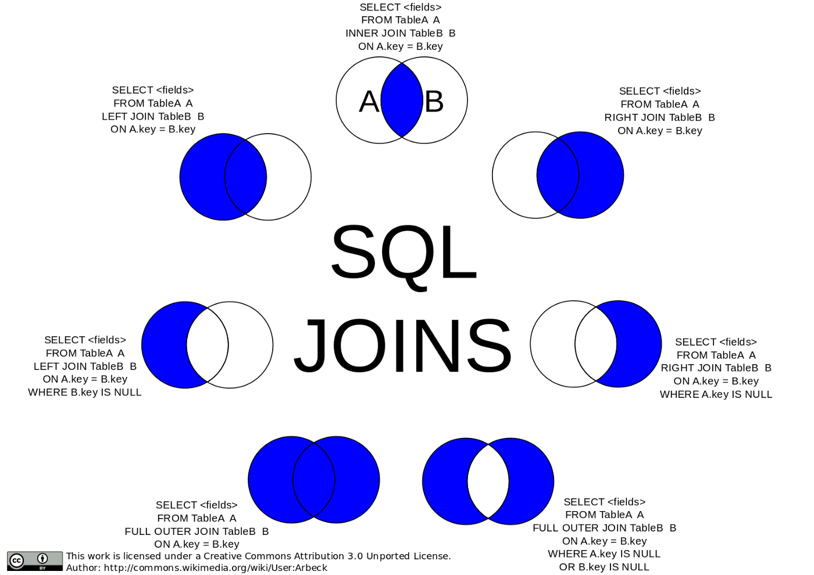
JOIN
Oh boy! Here’s the thing that turns some folks off…
Joins are a way to take two tables and make one bigger table.
There are a lot of joins, but I’ll let you in on a secret…
You only need to know LEFT JOIN.
…Maybe INNER JOIN…
One chord is fine, two chords are pushing it, three chords? Well now you’re getting into jazz.
-LOU REED, developer of the Velvet Underground SQL dialect

Slide 12
LEFT JOIN
SELECT c.firstname + “ “ + c.lastname AS fullname
FROM db.schema.customers c
LEFT JOIN db.schema.transactions t
ON c.customerid = t.customerid
WHERE c.country IN (“USA”,”Canada”)
, c.joinDate BETWEEN “2022-01-01” AND “2022-02-01”
, c.joinMachine = “181415”
LIMIT 100;
Joins occur in the FROM clause.
The table you’re joining is referenced right after the LEFT JOIN term.
Then, after the ON keyword you’ll establish the relationship between the primary keys.
In LEFT JOINs a row from the right table will be affixed to the left table if there’s a match, but we still keep all the records from the left table.

Slide 13
GROUP BY
SELECT c.firstname + “ “ + c.lastname AS fullname
, SUM(t.transactionamount) AS lifetimeValue
FROM db.schema.customers c
LEFT JOIN db.schema.transactions t
ON c.customerid = t.customerid
WHERE c.country IN (“USA”,”Canada”)
, c.joinDate BETWEEN “2022-01-01” AND “2022-02-01”
, c.joinMachine = “181415”
GROUP BY c.firstname, c.lastname
LIMIT 100;
The GROUP BY clause is used exclusively with aggregations.
When you aggregate one column, the other columns in your select clause need to be in the GROUP BY clause.
The ancient ones claim that the order matters, but the ancient ones say a lot of things…
Gandalf the DB

Slide 14
QUERY
SELECT c.firstname + “ “ + c.lastname AS fullname
, SUM(t.transactionamount) AS lifetimeValue
FROM db.schema.customers c
LEFT JOIN db.schema.transactions t
ON c.customerid = t.customerid
WHERE c.country IN (“USA”,”Canada”)
, c.joinDate BETWEEN “2022-01-01” AND “2022-02-01”
, c.joinMachine = “181415”
GROUP BY c.firstname, c.lastname
LIMIT 100;
Now you have a whole query that will show the lifetime transaction amounts for every name in the database sorted by state and then last name.
Now print to CSV from your RDBMS and get out of the office by 3!
“You can sort your life out anytime, but the bar closes in five hours.”
Bernard Black, Bookseller & Philosopher

Slide 15

Where next, Columbus?
Subqueries
CASE statements
Temporary tables
Window Functions
Query optimization
Stored Procedures
Database design
“You can technically design a whole application with stored procedures. You can also technically build a house out of dried cow patties…”
Abraham Lincoln, FORTRAN developer
Inventor of C++, Bjarne Stroustrup, playing it cool

